Slide 1
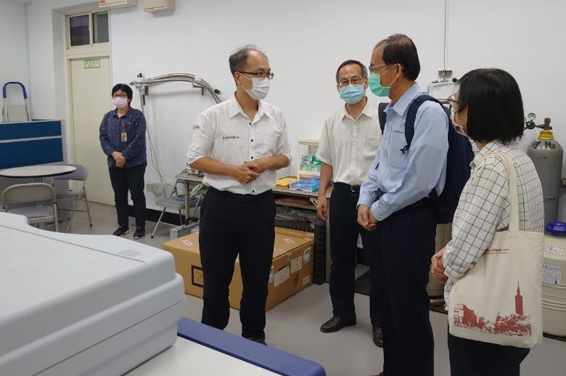
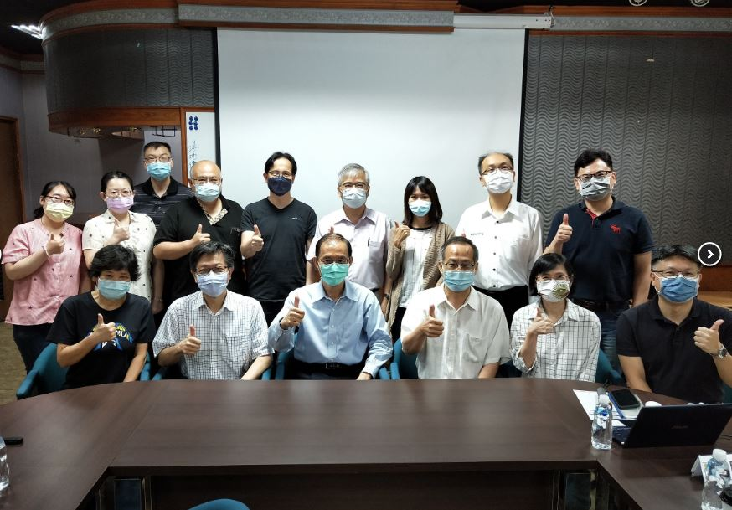
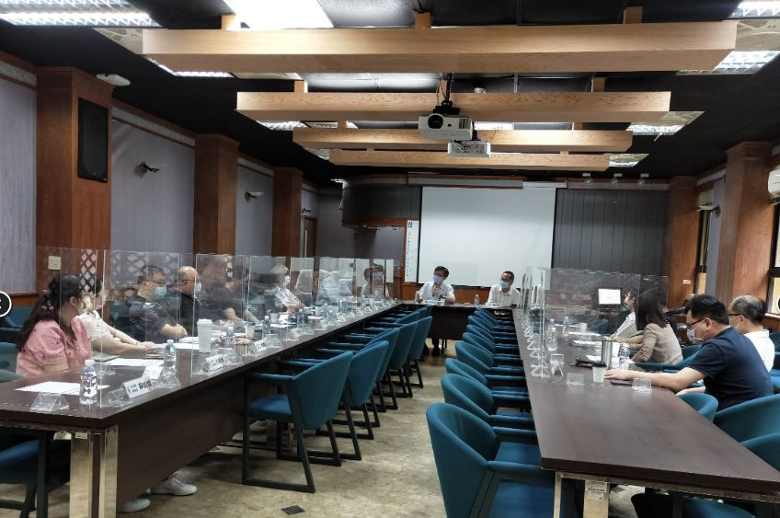
Professor Yue-Wern Huang Invited to Give Presentations at National Taiwan Normal University
Dr. Yue-Wern Huang, Professor of Biological Sciences at Missouri S&T, was invited to visit the College of Science of National Taiwan Normal University (NTNU) on June 16 and 17 to give a scientific presentation as well as interact with faculty and students for possible graduate studies and research collaboration at Missouri S&T.
Dr. Huang, a 74-class alumnus of the Department of Biology (now the School of Life Sciences) at NTNU, gave a seminar entitled, “Bioaerosol Detection to Electronic Cigarette Smoke: It is all about Particles”. Through this presentation, he demonstrated the feasibility and amazing outcome of interdisciplinary research that brought together biologists, engineers, and medical doctors. As issues in our society are becoming big, he encouraged faculty and students at NTNU to walk out of their comfort zone and team up with people across different disciplines to tack the ever growing and dynamic problems such as human health, global climate change, and biodiversity.
NTNU sent 22 graduate students to Missouri S&T through a scholar exchange program between 2009 and 2013. The program was fruitful and yielded many publications and research collaborations between the two universities. In this trip, Dr. Huang held two graduate study forums with faculty and students, he continued to encourage NTNU students to study overseas and faculty members to come to Rolla to visit our talented faculty to build novel research initiatives. During the visit, he was accompanied by College Dean Kunming Chen and Associate Dean Hsiu-Mei Hsieh for a tour to NTNU’s core facilities in chemistry and physics. At the end of the visit, Dean Guanqun Li of the School of Life Sciences presented Professor Huang with a certificate of gratitude to appreciate his long-term support of NTNU’s faculty and students.
https://pr.ntnu.edu.tw/ntnunews/index.php?mode=data&id=20882

